Slide 1





Trust4Futures
Prof Bill Buchanan OBE FRSE
https://trust4futures.com

Slide 2
Outline
This is a collaboration between Edinburgh Napier University, TAGES and Istanbul Blockchain Women and funded by the EIT Deep Tech Talent Initiative of the European Institute of Innovation and Technology (EIT).
This EIT Deep Tech Talent Initiative-funded project provides free training in areas of Cryptography, Blockchain, Post Quantum Cryptography and Privacy-aware AI.
We aim to provide coverage of the foundation elements of digital trust and showcase how trusted applications and services can be built.

Slide 3
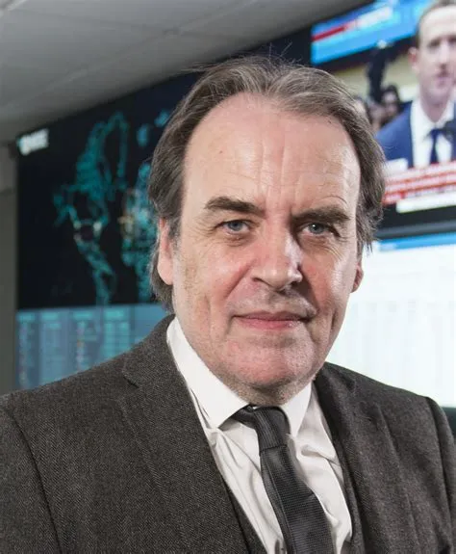
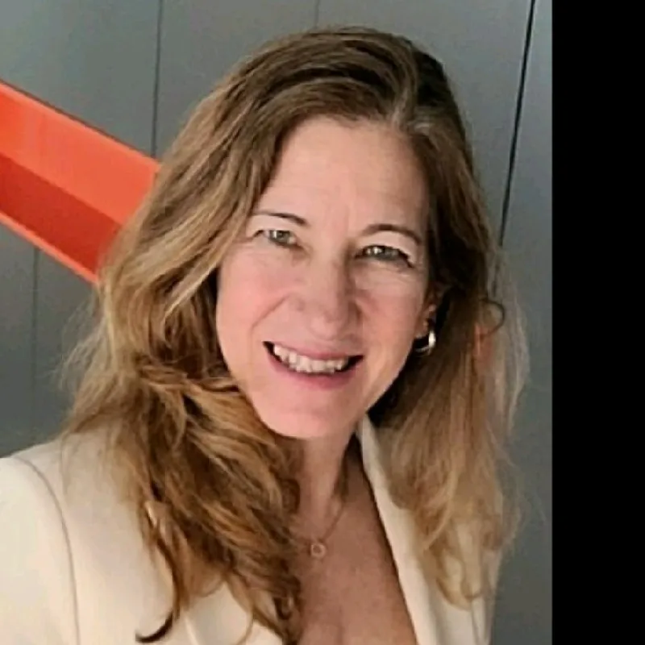

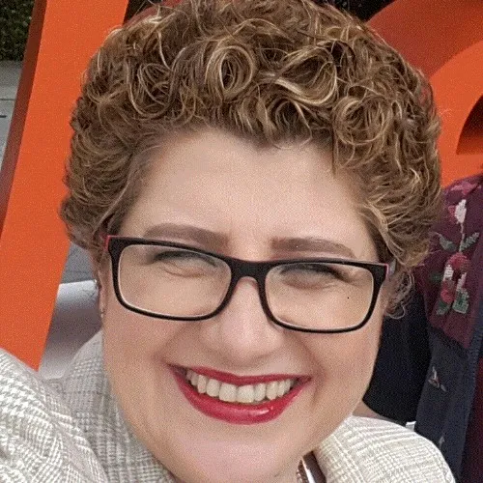
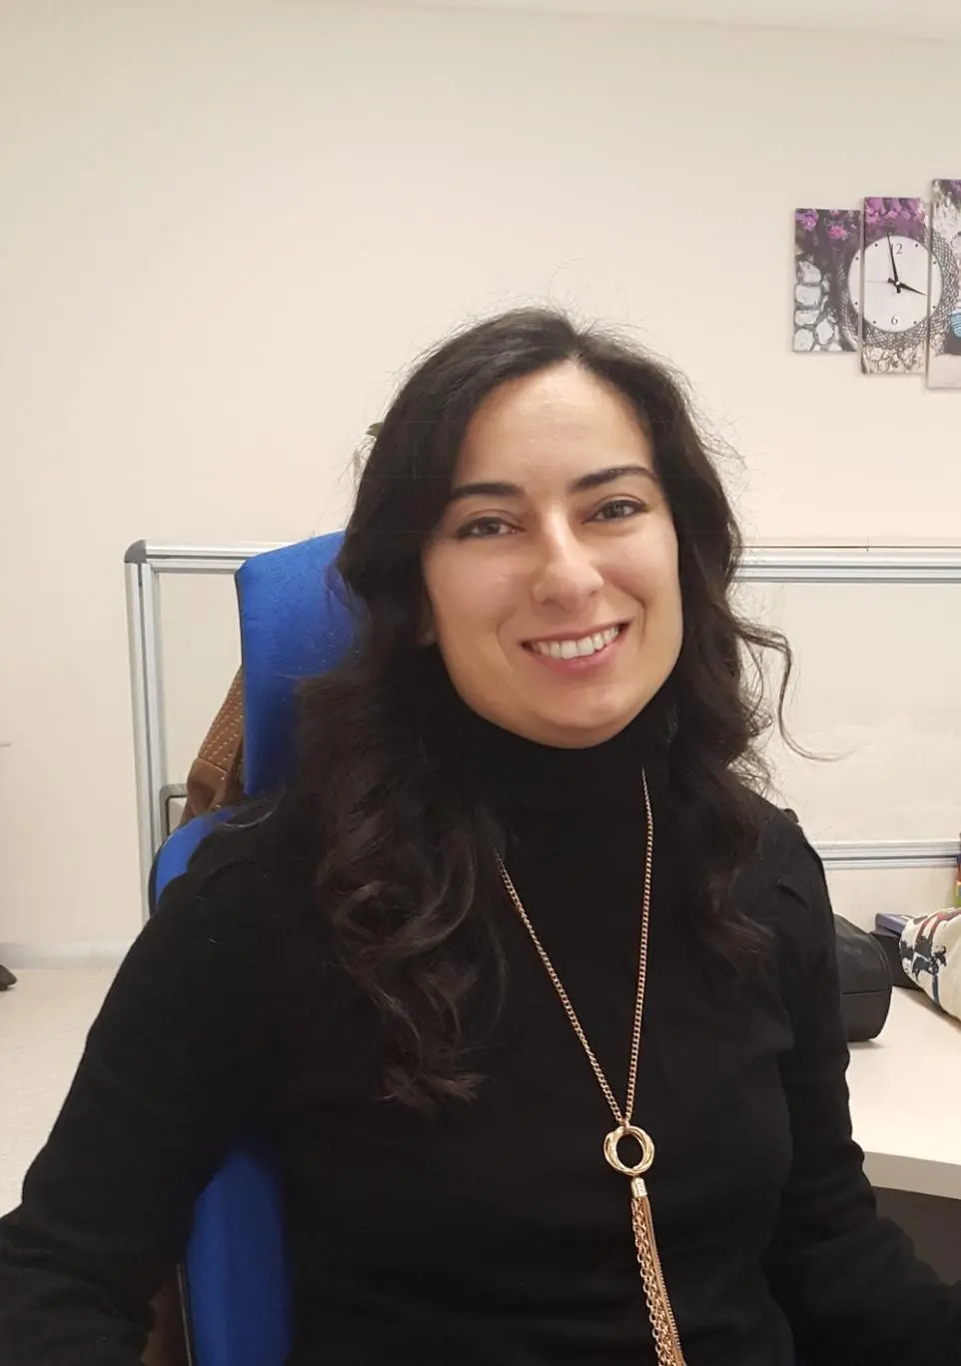
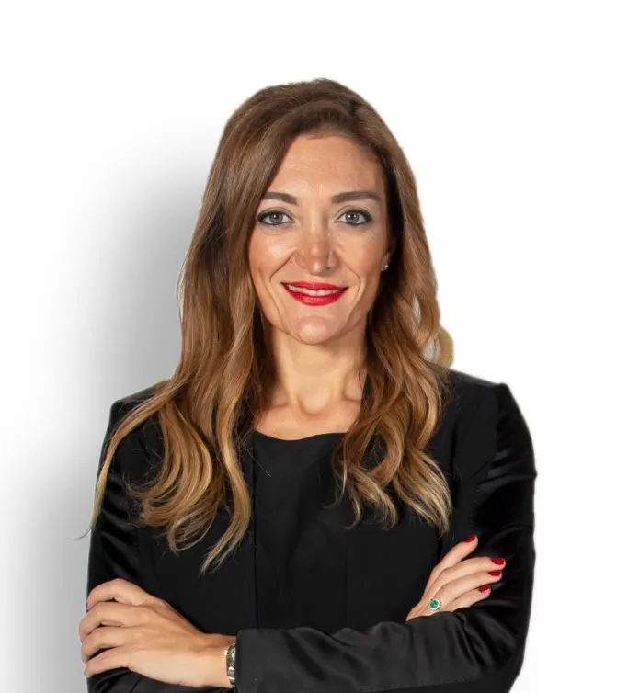

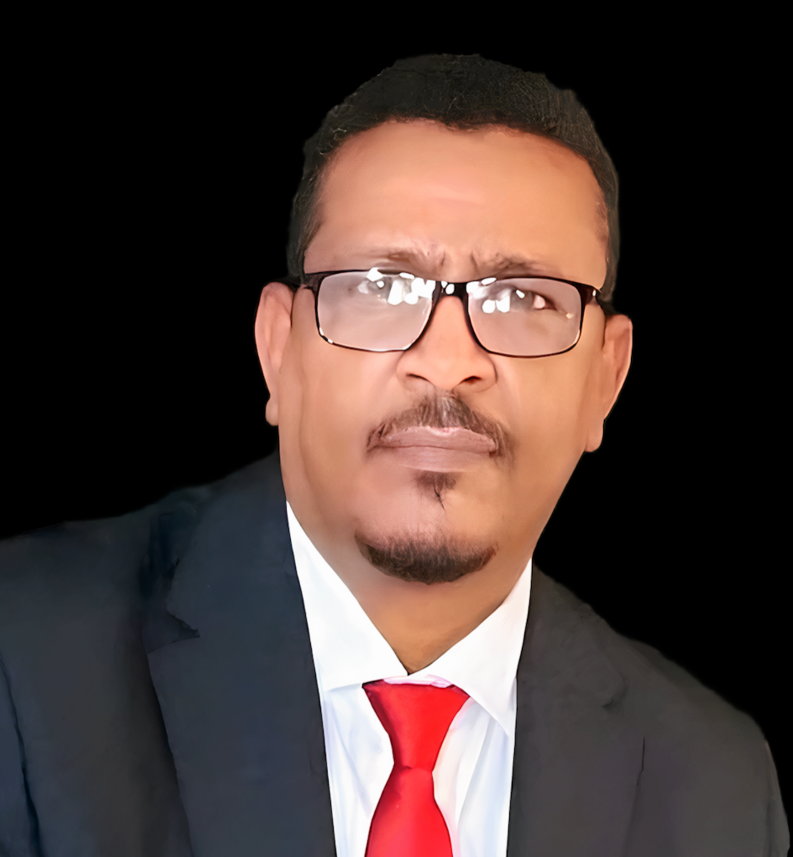
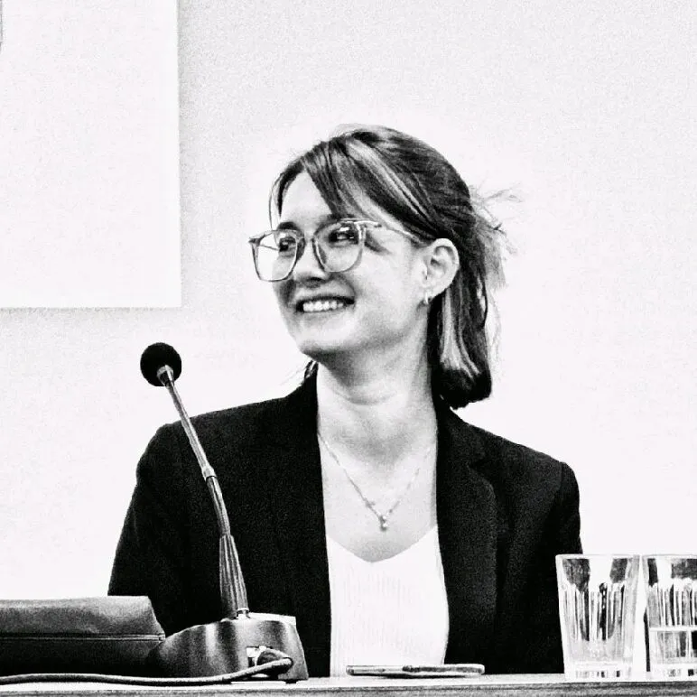
About Us
https://trust4futures.com/about/

Slide 4
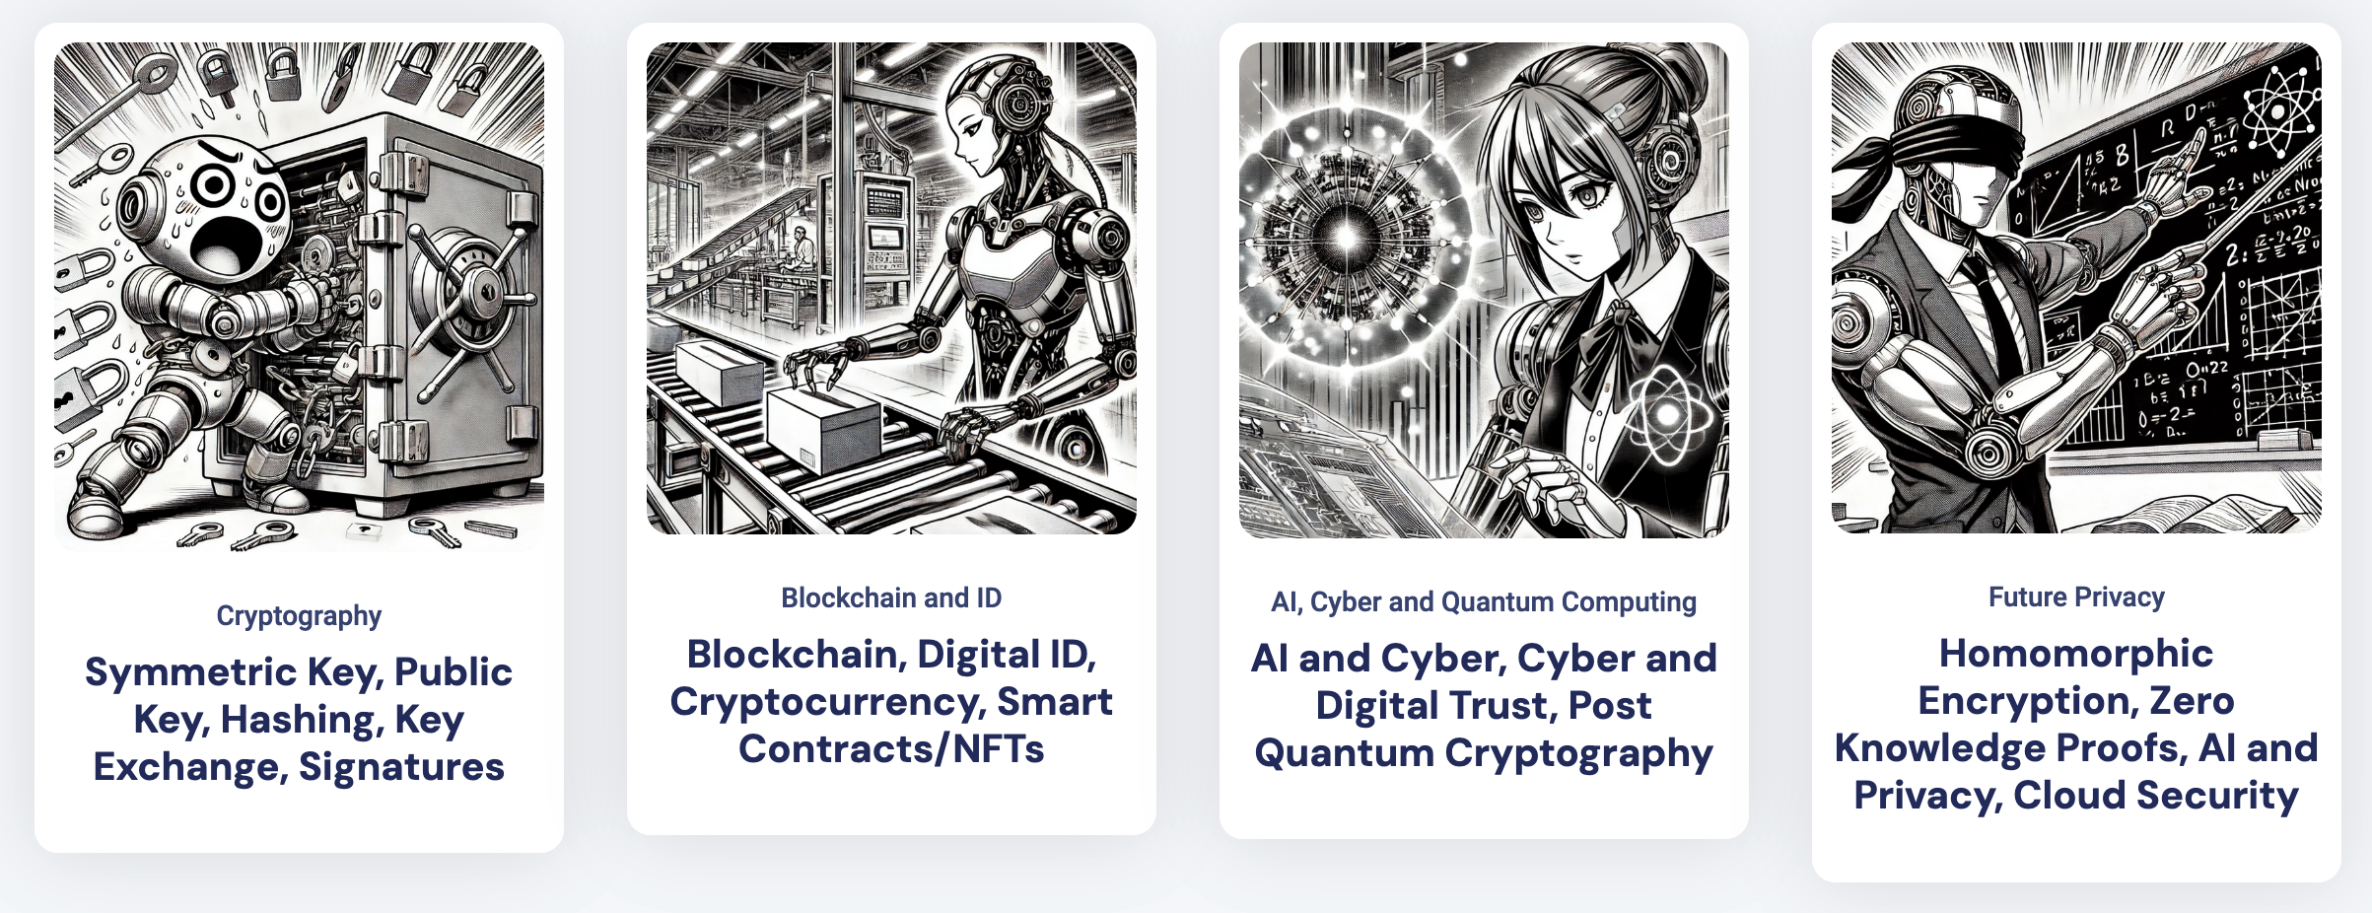
Workshops

Slide 5
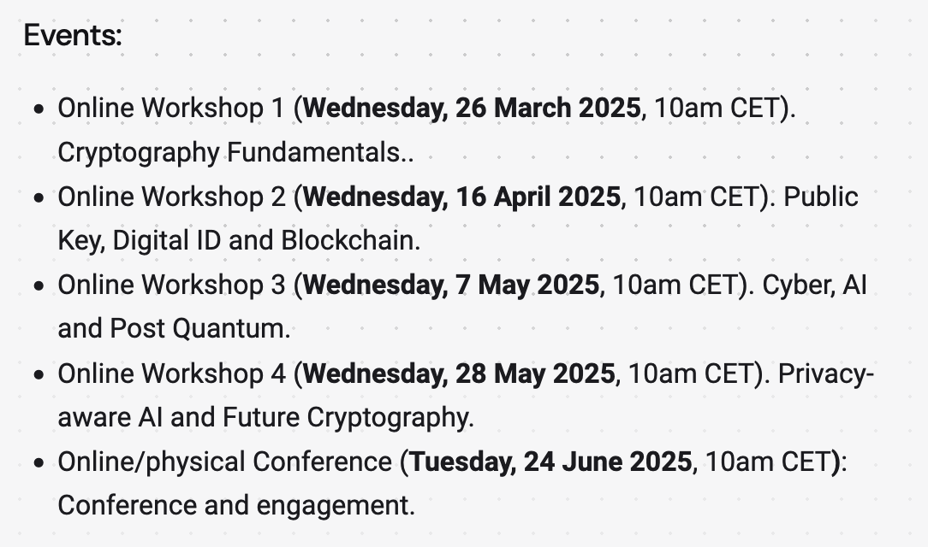
Events

Slide 6
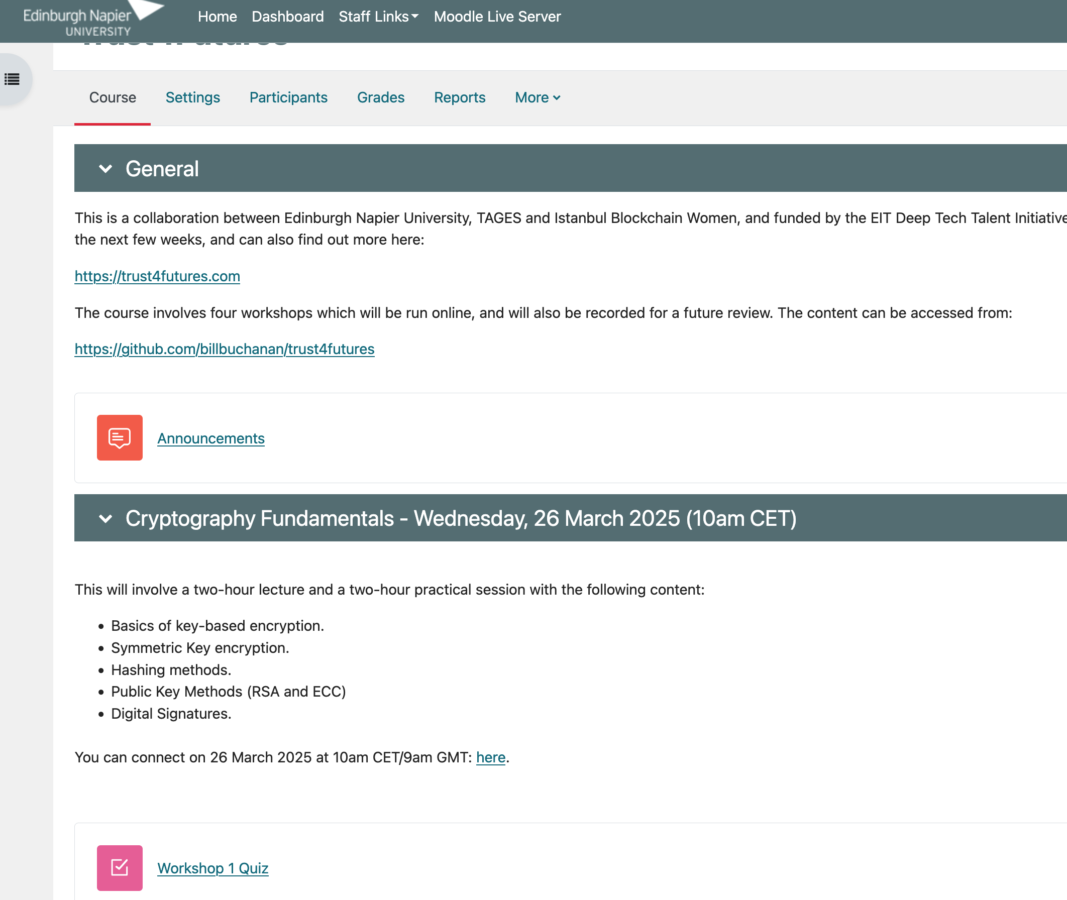
Moodle

Slide 7
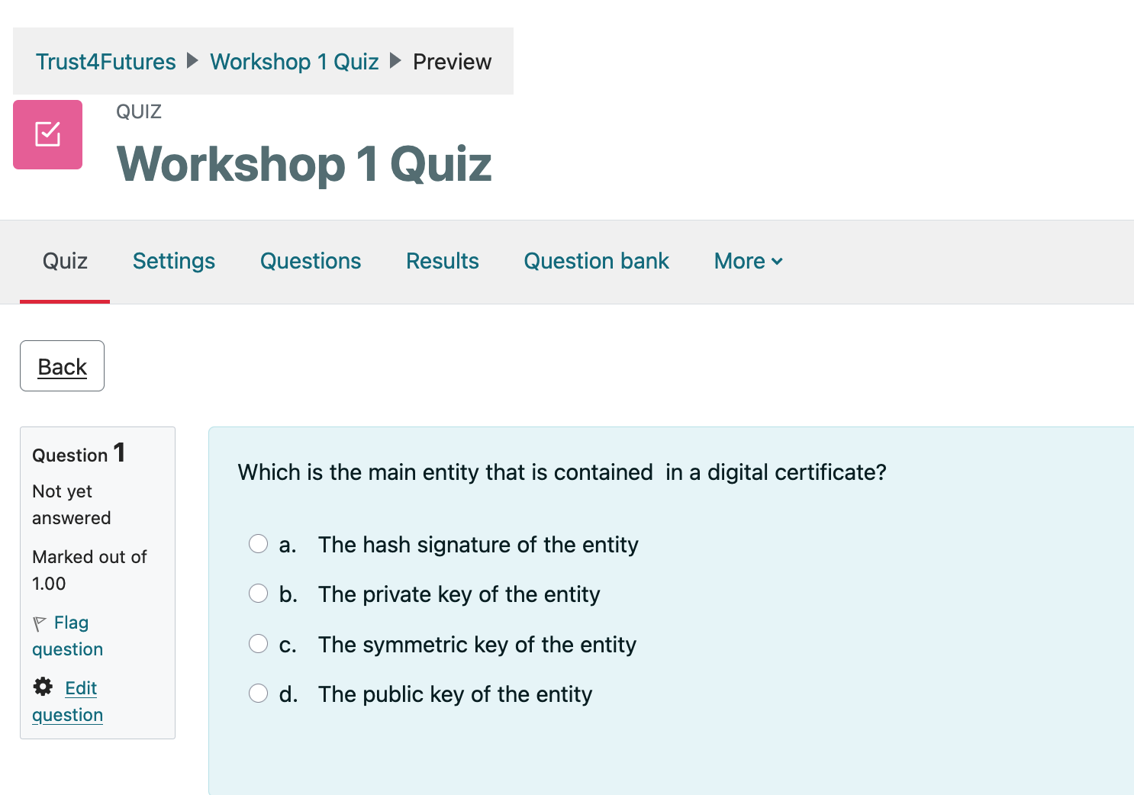
Moodle

Slide 8
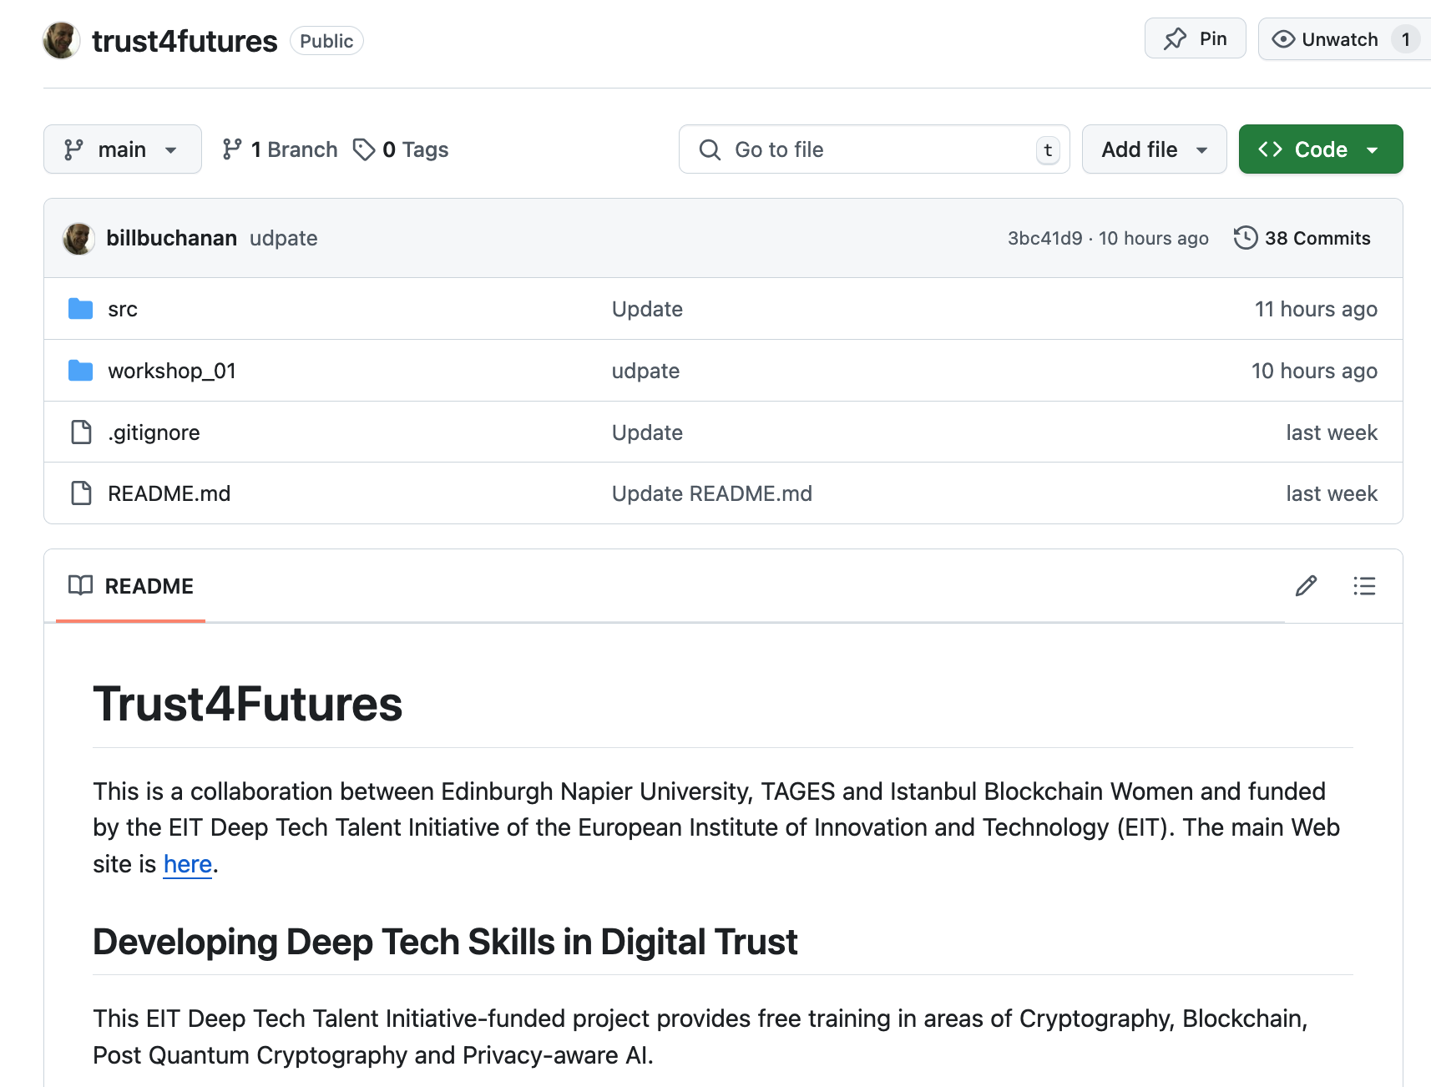
GitHub

Slide 9
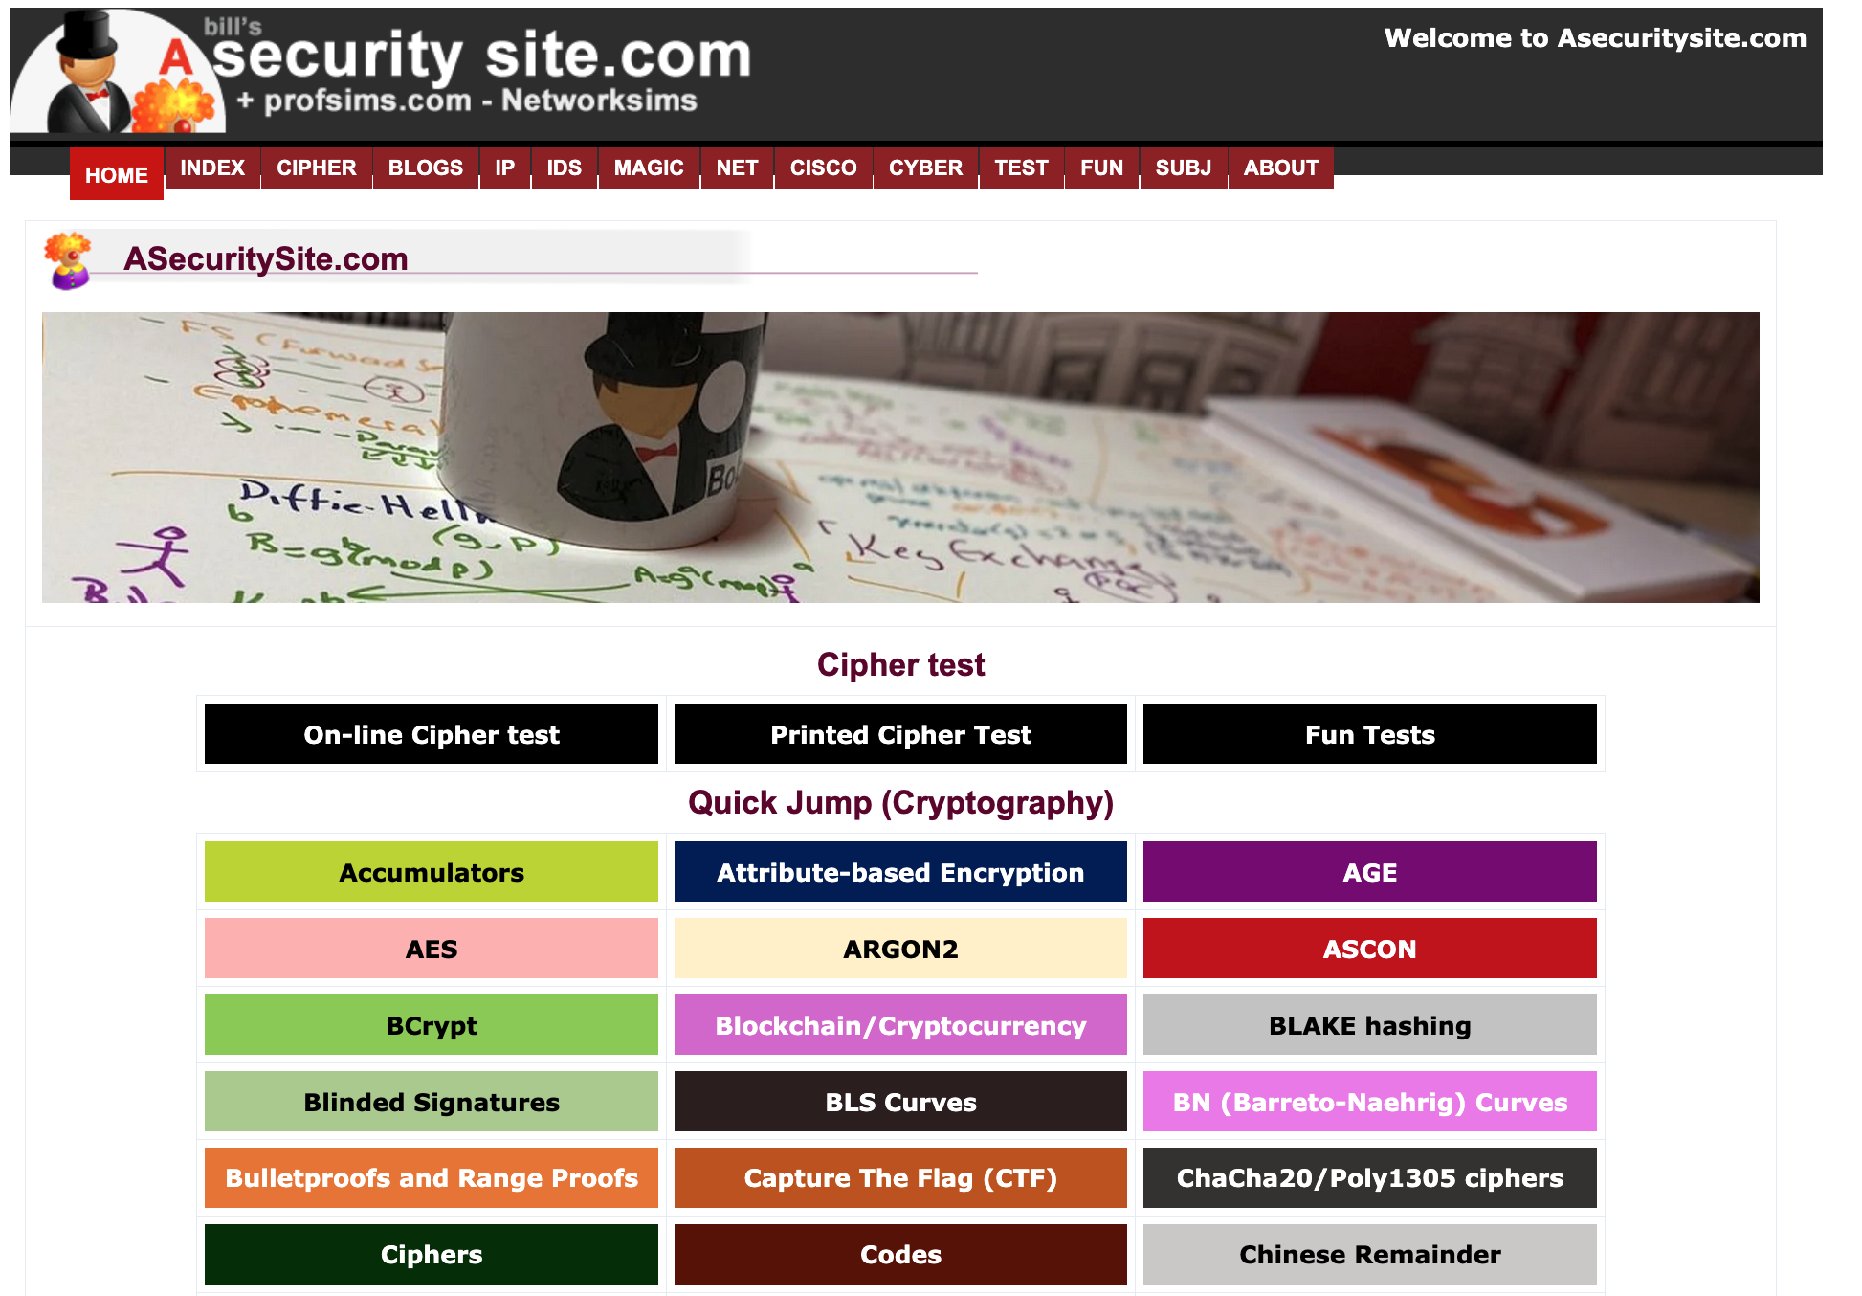
ASecuritySite

Slide 10
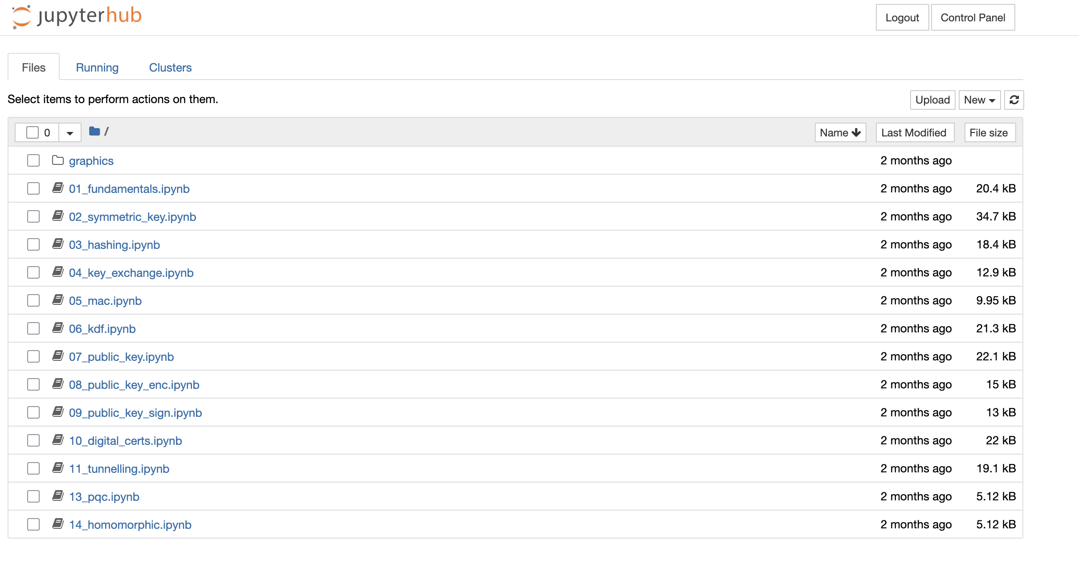
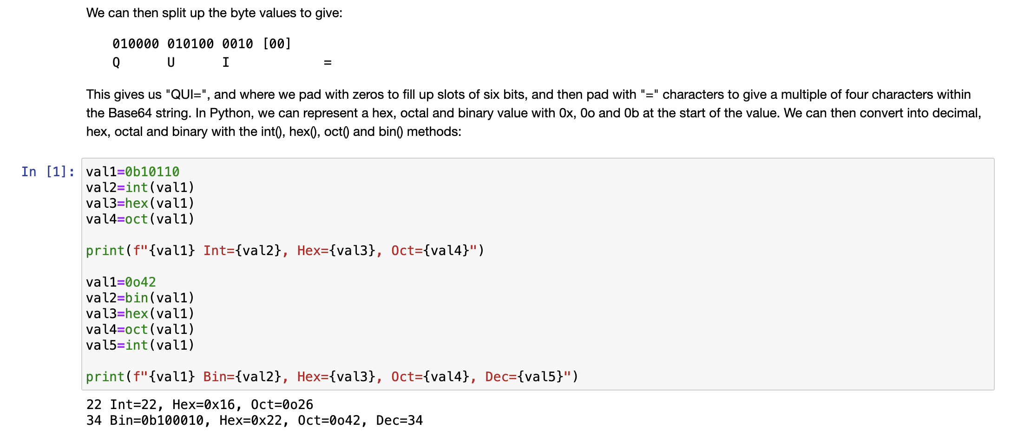
Juypterhub

Slide 11
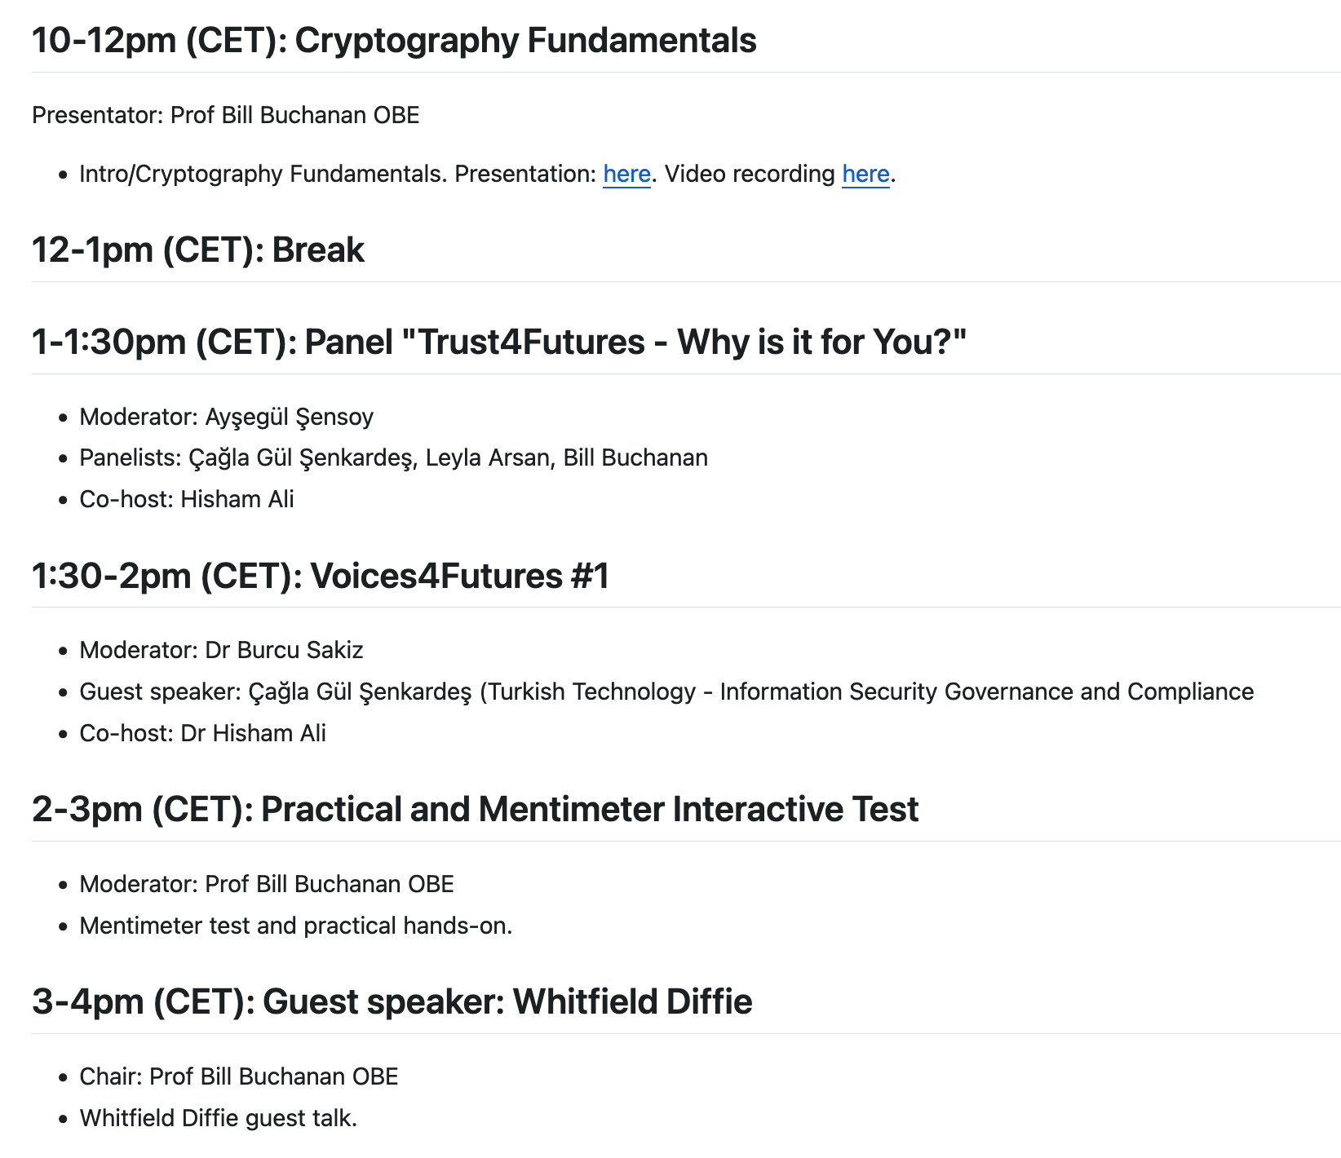
Workshop 1

